Slide 1
Implementation of Classification and DSS To Diagnose Obesity in a Person
Prepared by : Bishal Adhikari
Date : June, 2022

Slide 2
Introduction
In this project, we are analyzing a dataset which classifies obesity levels in a patient based on different attributes. The dataset is taken from UCI Machine Learning Repository and contains 2111 instances and 17 attributes. The original data classifies a broad category of obesity , overweight levels, underweight condition and normal weight condition. For convenience we have reduced the classes to three categories : ‘Obesity’, ‘Overweight’ and ‘No Obesity.’

Slide 3
Goal of the project
To conduct classification on obesity dataset using DecisionTreeClassifier
To understand how the different hyperparameters affect the accurracy of the classifier mmodel
To use the result of classification to derive a rule-based program(DSS) that diagnose obesity levels
To use DSS to predict the obesity levels in a person based on certain attributes

Slide 4
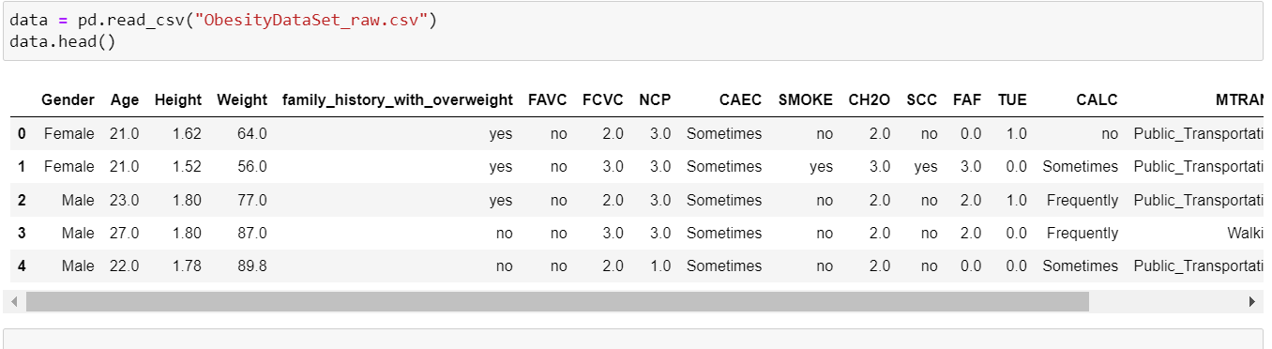
DATASET
This dataset include data for the estimation of obesity levels in individuals from the countries of Mexico, Peru and Colombia, based on their eating habits and physical condition.

Slide 5
Attributes
Frequent consumption of high caloric food (FAVC)
Frequency of consumption of vegetables (FCVC)
Number of main meals (NCP)
Consumption of food between meals (CAEC)
Consumption of water daily (CH20)
Consumption of alcohol (CALC)
Calories consumption monitoring (SCC)
Physical activity frequency (FAF)
Time using technology devices (TUE)
Transportation used (MTRANS)
Gender
Age
Height
Weight.

Slide 6
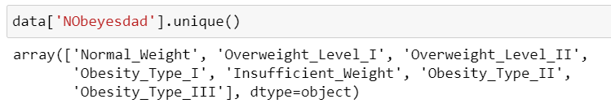
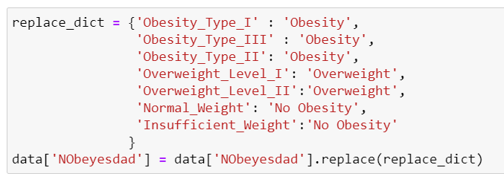

Classification Targets
Original Targets(7 classes)
Operation
Modified Targets(3 classes)

Slide 7
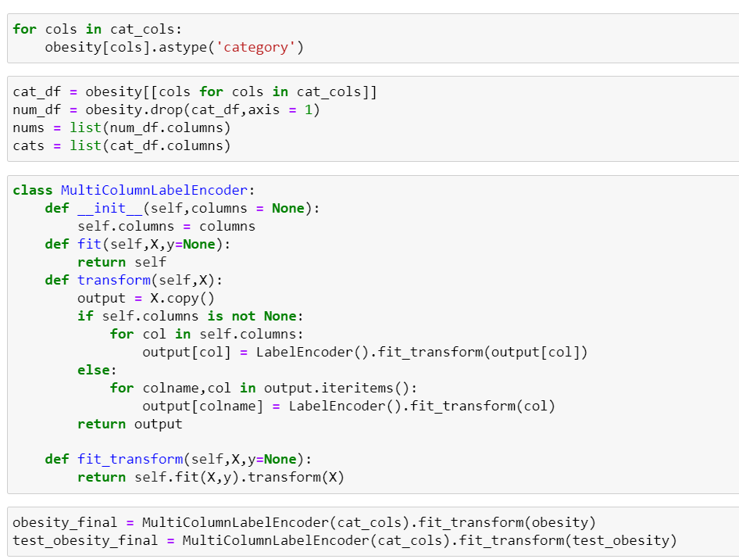
Data Preparations
All categorical columns were
encoded using labelencoder.
Numeric columns were not scaled.

Slide 8
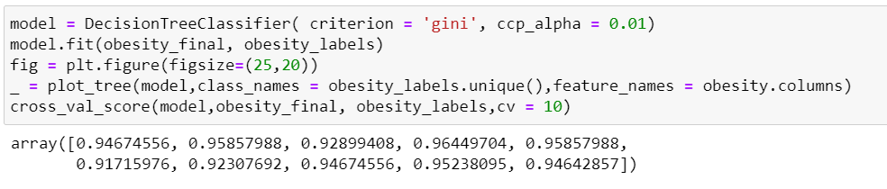
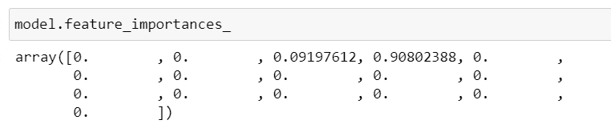
Running Classifier
Run 1(criterion = gini, ccp_alpha = 0.01) ccp-alpha is responsible for pruning trees

Slide 9
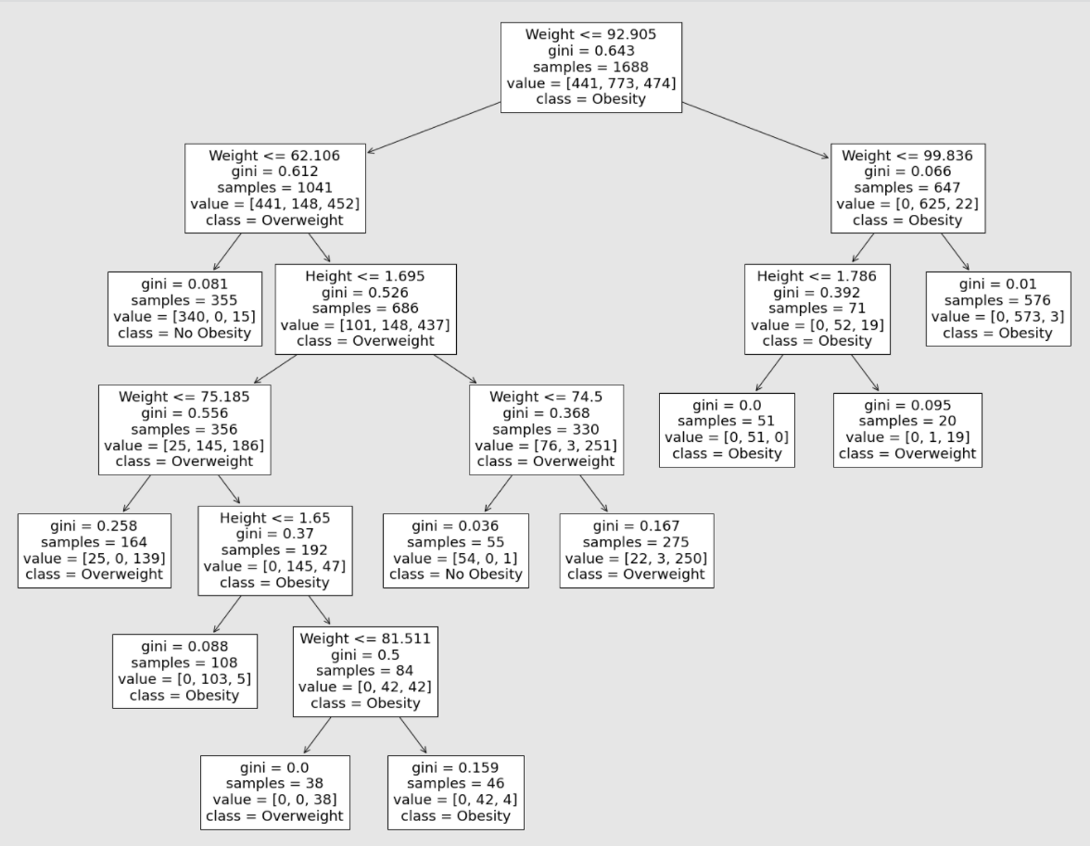
Decision Tree from Run #1

Slide 10
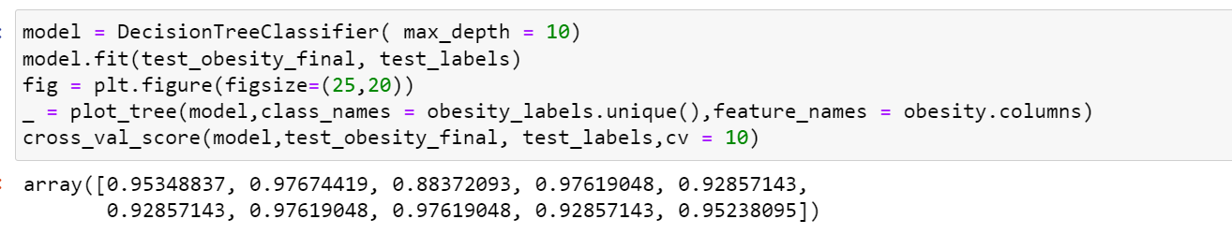
Run #2(max_depth = 10) no pruning
With higher max_depth, the accurracy improved but the tree became complex.

Slide 11
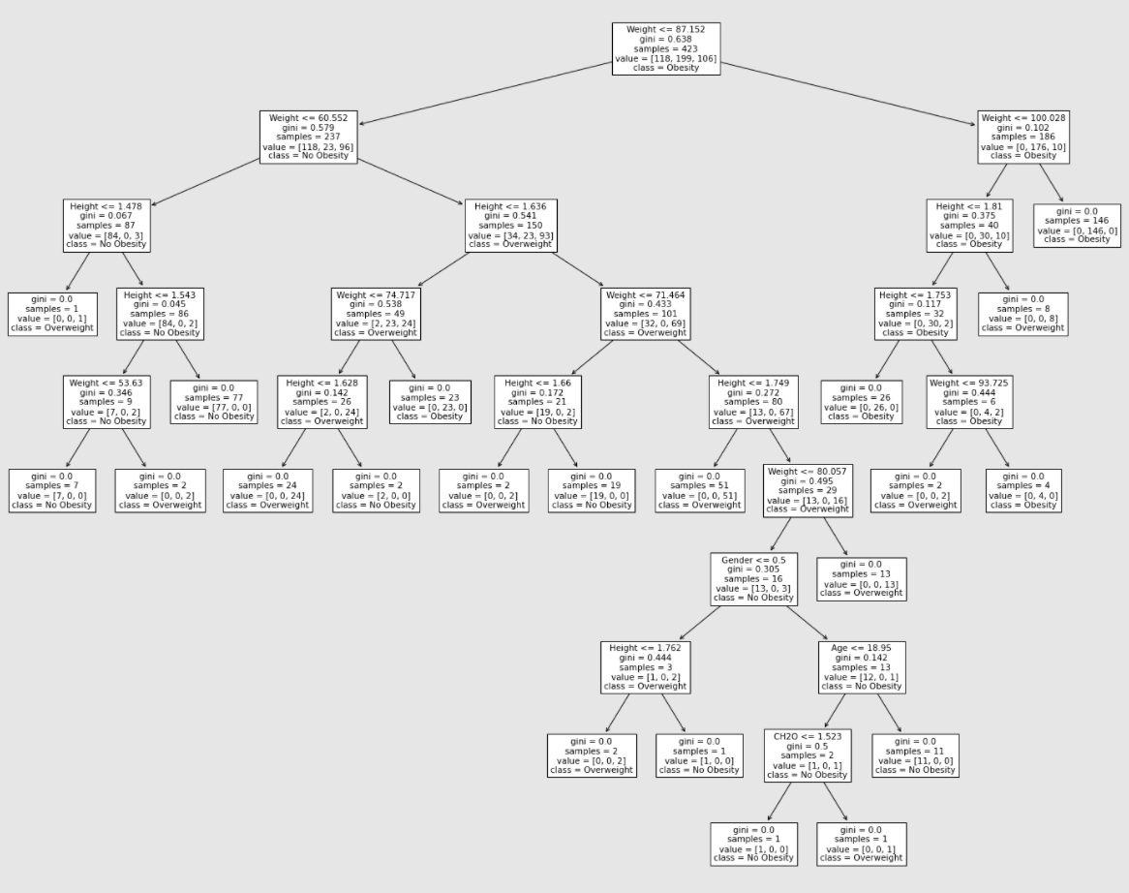
Decision Tree from Run#2

Slide 12
As we saw in Run #1 and Run #2 , with no pruning in Run #2 the tree was very complex and was dependent on more attributes.
But in Run #1 effective pruning allowed the tree to remain small , depend on less/best attributes and still gave the similar accurracy.

Slide 13
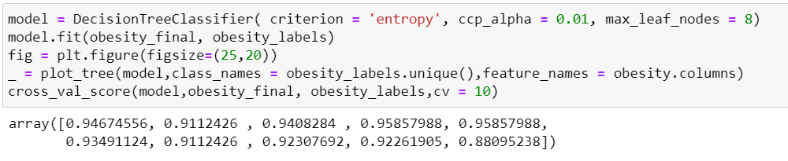
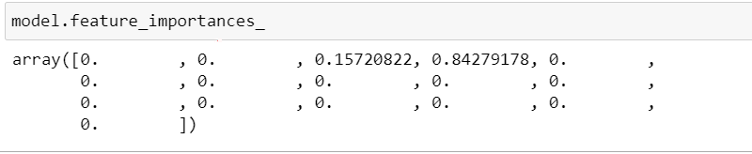
Run 3 (criterion = entropy, ccp_alpha = 0.01, max_leaf_nodes = 8)

Slide 14
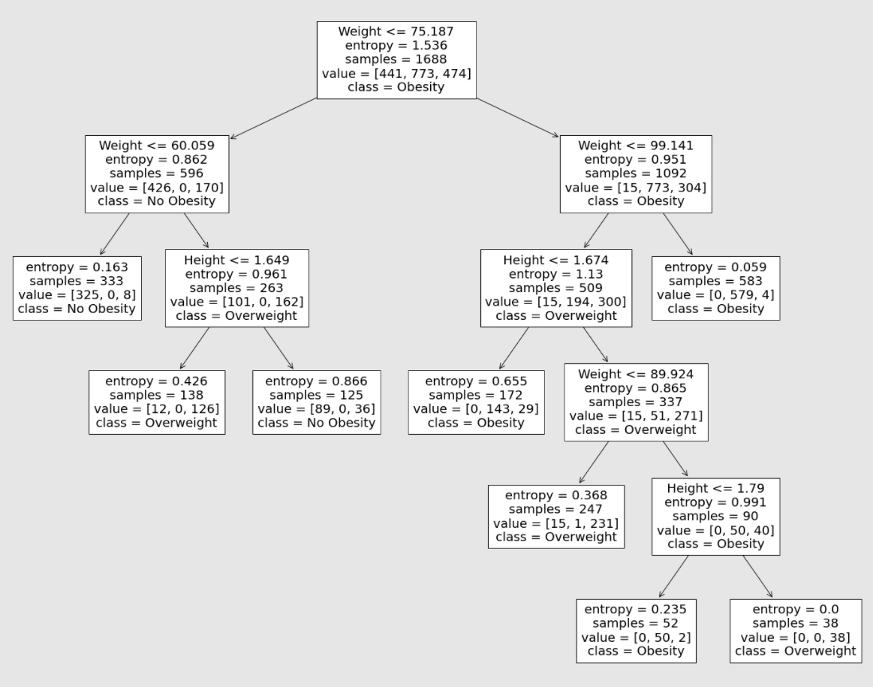
Decision Tree from Run #3

Slide 15
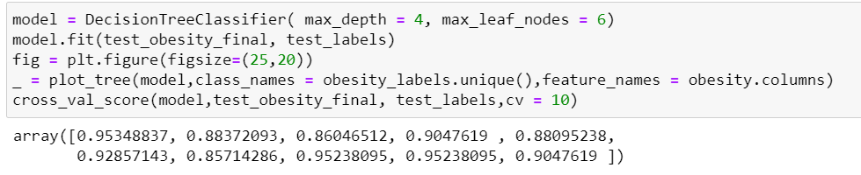
Run #4( max_depth = 4, max_leaf_nodes = 6)

Slide 16
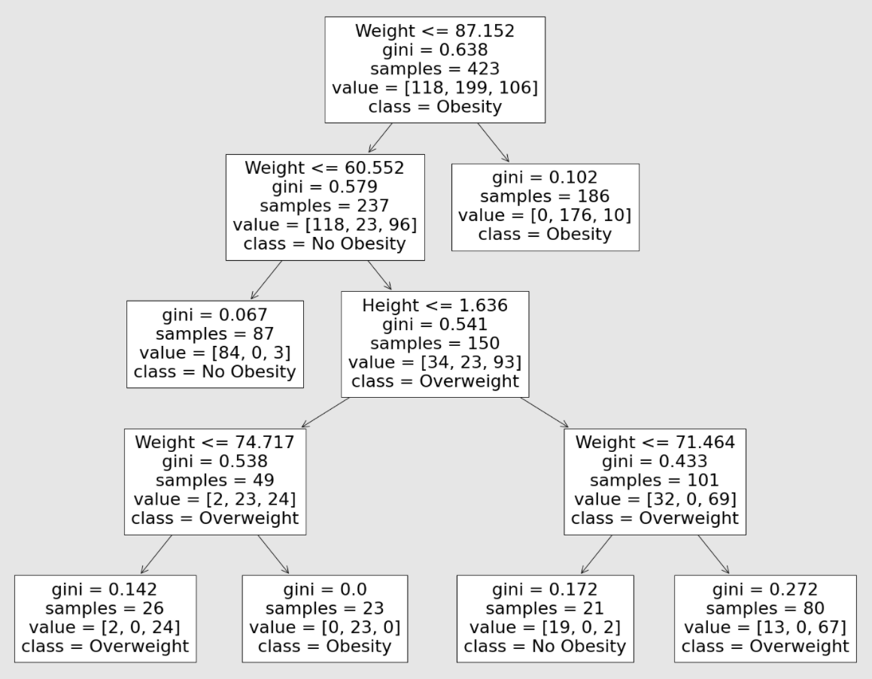
Decision Tree From Run #4

Slide 17
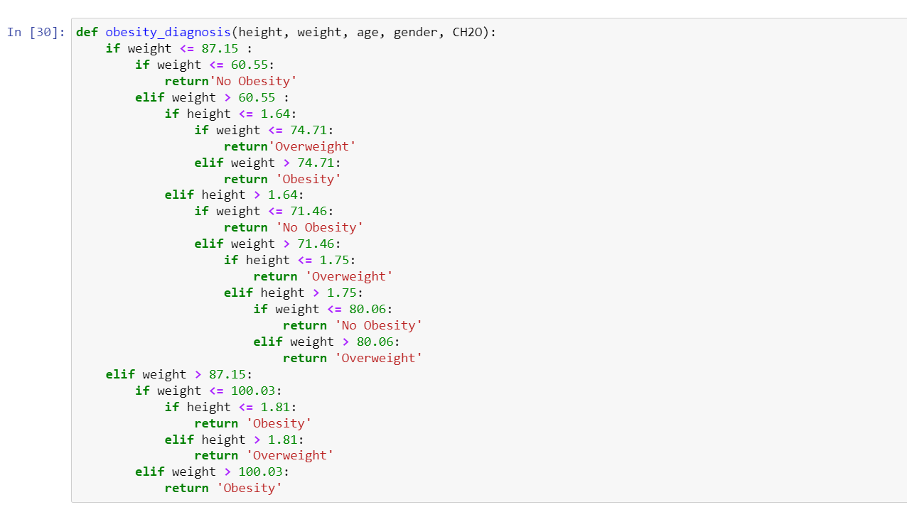
Decision Support System
Rules manually derived from a selected decision tree

Slide 18
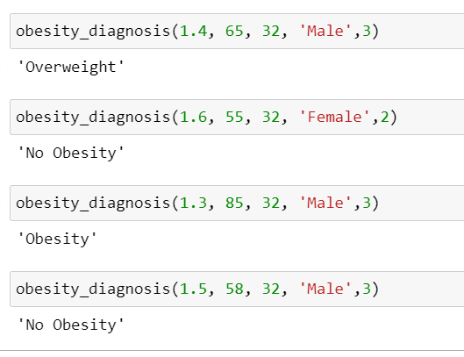
Test Run DSS

Slide 19
CONCLUSIONS
Hence, we successfully implemented Decision Tree Classifier to the obesity dataset. We saw that among all the attributes, most of the information was contained by only weight and height.
We got accurracy as high as 97% with the decision trees and it was surprising to see that with only height and weight, obesity levels of a person coold be identified or diagnosed.
Regarding hyperparameters:
other parameters constant, increasing max_depth increased accurracy of the model
max_leaf_nodes did the same as max_depth in contributing to accurracy
pruning of trees by specifying ccp_alpha was very helpful in getting high accurracy with less complicated trees
calculation of information gain using either gini or entropy didn’t affect the accurracy of our model in big way

Slide 20
We hereby conclude, DecisionTree Classifier is a powerful tool . Using Decision Trees it is possible to derive simple rules in predicting classes (obesity levels) in our case.
!! THANK YOU!!

